Slide 1
Infosys Springboard · Team D
PredictIQ
A predictive-maintenance dashboard that streams live sensor data over MQTT, scores machine health in real time, alerts the team automatically, and now answers questions about its own results through a built-in assistant.
● V1 — feature complete
github.com/Charankumm/InfosysSpringBoard-Team-D

Slide 2
Why bother with this
Most machines don't warn you before they fail.
Plants usually run one of two playbooks: fix it once it's broken, or service it on a fixed calendar whether it needs it or not. Neither one actually looks at what the machine is telling you.
Reactive
wait for it to break
downtime + emergency repair costs
Scheduled
service on a fixed calendar
wastes labor on parts that were fine
Predictive — ours
watch the sensor data, ask it questions
risk flagged early, explained in plain language
The Problem
02

Slide 3
What we built
Everything PredictIQ does
—
Streams live sensor data over MQTT
—
Built-in PredictIQ Assistant
temperature, torque, speed, tool wear — arriving in real time
a chat panel that explains any result in plain language
—
Predicts failure probability
—
Shows it all on one dashboard
and the likely failure type, not just a yes/no
health score, gauge, trend, AI notes
—
Flags anomalies early
—
Keeps a prediction history
before a reading crosses into outright failure
so you can see how a machine trended over time
—
Sends an email the moment it's critical
—
Runs on our own local server
fires automatically, no one has to be watching
no external AI service required for the assistant
Features
03

Slide 4
Under the hood
Sensor in, answer out
Live Sensor Feed
Flask Backend
ML Models
Prediction Engine
Dashboard
PredictIQ Assistant
MQTT stream
REST API
XGBoost, LSTM, RF
probability + type
gauge, trend, alerts
local inference server
A reading streams in over MQTT, the model scores it, the dashboard shows the result, a critical score triggers an email — and the assistant sits alongside all of it, able to answer questions about any of these steps on demand.
Dashboard
Email alert
Assistant
live gauge + trend chart
fires automatically, confirmed working
explains results, suggests fixes, lists contacts
Architecture
04

Slide 5
What it's made of
The stack
Backend
Python, Flask / FastAPI
Live ingestion
MQTT — streams sensor readings straight into the prediction engine
Machine learning
Scikit-learn, TensorFlow, XGBoost, Random Forest, LSTM
Assistant
Local inference server — reads live status, history & contacts, no external AI service
Frontend
HTML5, CSS3, JavaScript (ES6), Chart.js
Notifications
Automated email alerts
Training data
AI4I 2020, NASA C-MAPSS, CWRU Bearing, Azure PdM
Tech Stack
05

Slide 6
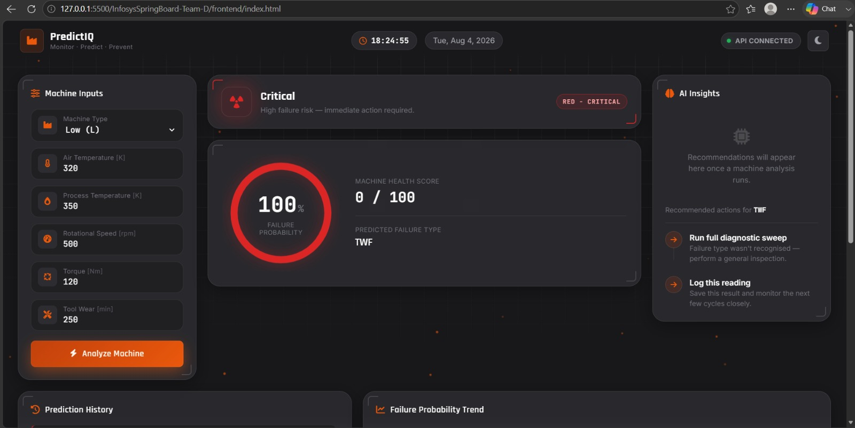
First test run
We fed it a bad reading —
it caught it.
Low-torque input with high tool wear. The model called it correctly and flagged the exact failure mode.
Failure probability
100%
Health score
0 / 100
Failure type
TWF — tool wear
localhost — dev build, Aug 4
Dashboard
06

Slide 7
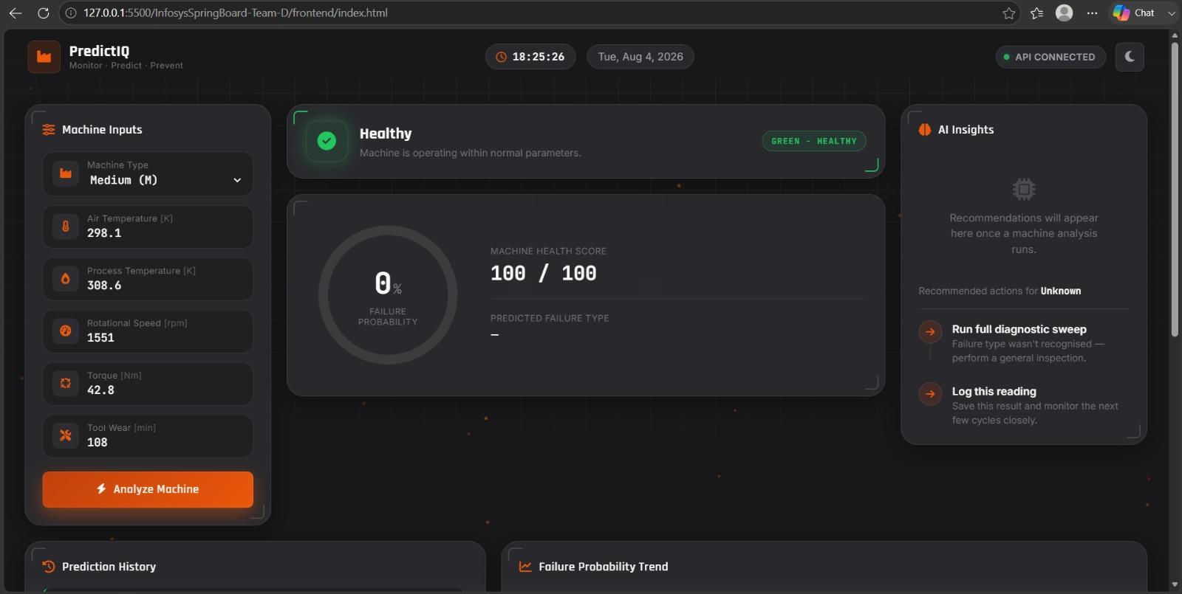
Second test run
Then a normal reading —
and it stayed quiet.
Same model, same session, ordinary parameters this time. It didn't cry wolf — good sign it's actually discriminating, not just alarming.
Failure probability
0%
Health score
100 / 100
localhost — dev build, Aug 4
Failure type
— none flagged
Dashboard
07

Slide 8
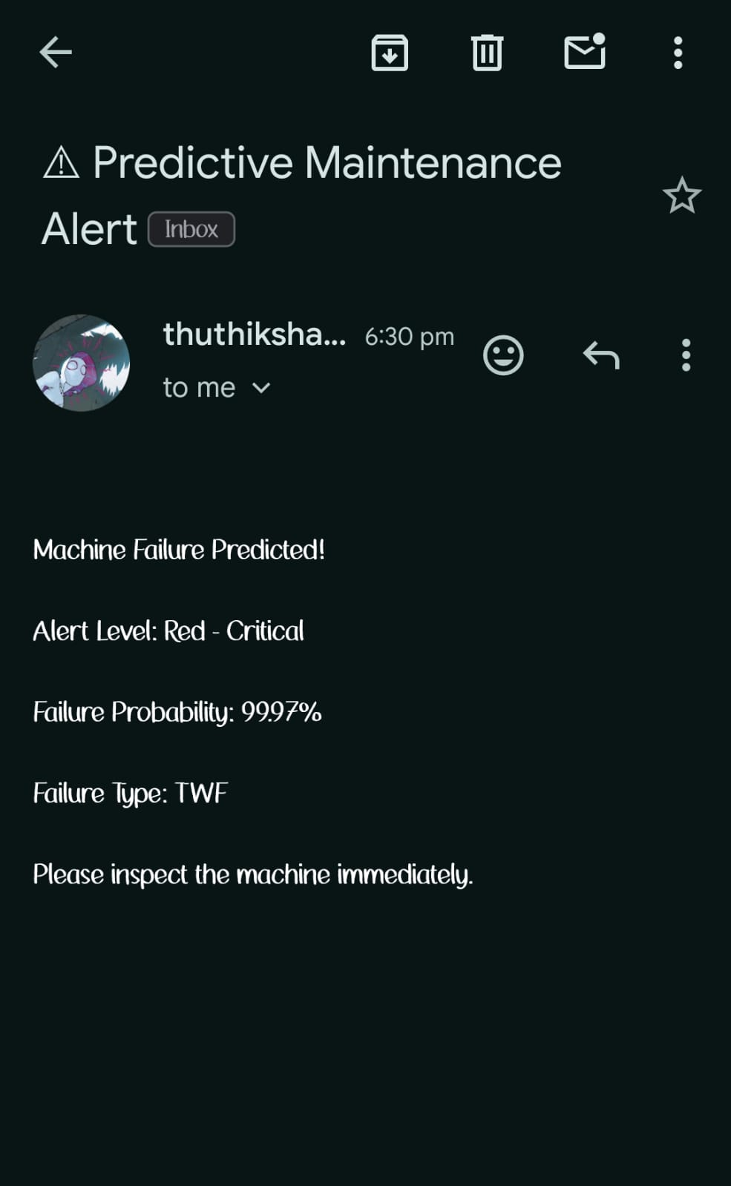
It doesn't need babysitting
The alert email is real —
this is an actual inbox.
When a reading crosses into critical territory, the Flask backend fires an SMTP email on its own — no one has to remember to check.
Trigger
probability crosses the critical threshold
Payload
probability, failure type, an action prompt
Status
working end-to-end, confirmed live
Alerts
08

Slide 9
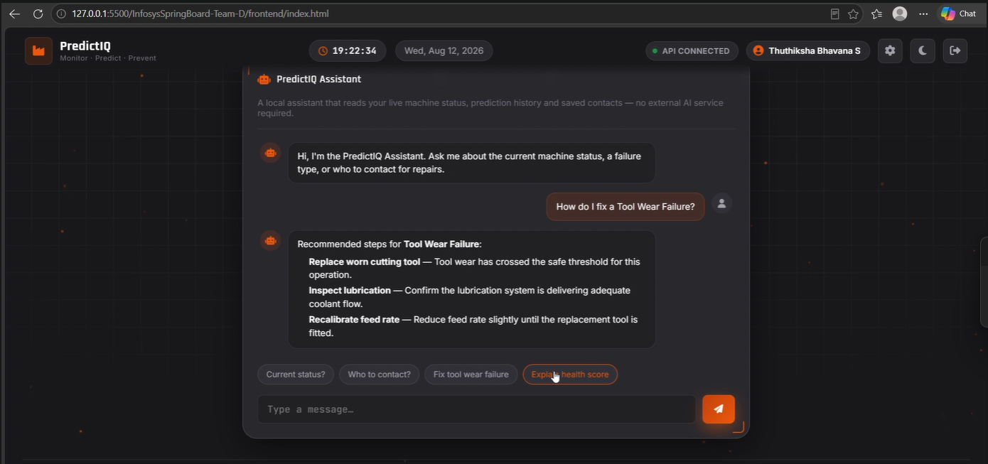
New this build
Meet the PredictIQ
Assistant.
A chat panel built into the dashboard. It reads the live machine status, the prediction history and our saved contacts — then answers in plain language. Runs on our own local server, so there's no external AI service in the loop.
“How do I fix a Tool Wear Failure?”
walks through replace tool → check lubrication → recalibrate feed rate
“Who do I contact for repairs?”
pulls the right contact from saved records
localhost — dev build, Aug 12
“Explain the health score”
translates the number into plain language
No external AI service — the assistant runs entirely on our own local server.
Assistant
09

Slide 10
Start to finish
What happens on one reading
1
A sensor reading streams in over MQTT
no manual entry needed
2
The Flask backend scores it
returns a failure probability and a type
3
The dashboard updates live
gauge, trend chart, AI notes
4
The reading joins prediction history
automatically, as it arrives
5
If it's critical, an email goes out
automatically, no one has to trigger it
6
The assistant is ready with answers
ask it what happened, or what to do next
Workflow
10

Slide 11
Where things stand
V1 is complete
Every feature we scoped for this build works end to end — streaming a live reading in over MQTT, scoring it, showing it, emailing it, and now explaining it through the assistant.
100%
Core system
Alerts & assistant
Verified
✓
Live sensor ingestion — MQTT
✓
Email alert fires automatically
✓
Tested against a critical reading
✓
Flask backend, live API connection
✓
PredictIQ Assistant — local, in-dashboard
✓
Tested against a healthy reading
✓
Failure prediction — probability + type
✓
Explains results & recommends fixes
✓
MQTT stream tested live
✓
Healthy vs. critical, checked both ways
✓
Looks up saved repair contacts
✓
Assistant tested on live queries
Status
11

Slide 12
What's next
Taking it beyond V1
Deploy to a live server
move off localhost onto a hosted environment the whole team can reach
Add persistent storage
carry prediction history and assistant context across sessions
Scale the MQTT feed
go from one test machine to a full fleet of sensors streaming at once
Prescriptive recommendations
have the assistant suggest the fix, not just explain the risk
Thanks for reading — PredictIQ, Team D, Infosys Springboard Internship Program.
github.com/Charankumm/InfosysSpringBoard-Team-D

